Slide 1


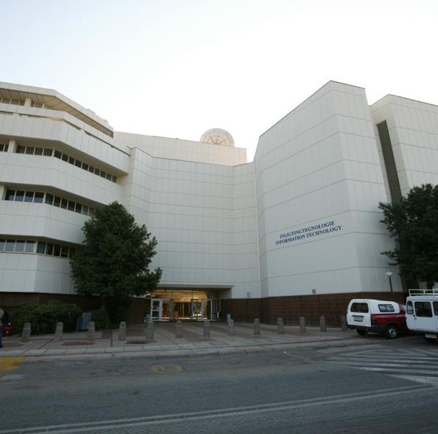
Evolutionary Algorithms
10 April 2018

Slide 2
Evolutionary Algorithms
Optimization and search
Single point search vs. multipoint search
Based on Darwin’s theory of evolution
Evolutionary algorithms:
Genetic algorithms
Genetic programming
Evolutionary programming
Evolutionary strategies
COS 710: Evolutionary Algorithms

Slide 3
Case Studies

Slide 4
Examination Timetabling Problem (ETP)
The examination timetabling problem involves scheduling examinations to timetable periods. Allocations must be made so that the hard constraints of the problem are met and the number of soft constraints are minimized.
COS 710: Evolutionary Algorithms

Slide 5
Travelling Salesman Problem (TSP)
The travelling salesman problem involves determining the minimum distance route that a travelling salesman must follow. The route must begin and end at the same city and no city must be revisited.
COS 710: Evolutionary Algorithms

Slide 6
The Evolutionary Algorithm

Slide 7
Generational Evolutionary Algorithm
Create an initial population
Repeat
Calculate the fitness of the population
Select parents
Apply genetic operators to the parents
Until a termination criterion is met
COS 710: Evolutionary Algorithms

Slide 8
Important Concepts in Evolutionary Algorithms
Global optimum vs. local optimum
Random search vs. convergence
Premature convergence – local optimum
Diversity
COS 710: Evolutionary Algorithms

Slide 9
Initial population and representation
Each element of the population is a chromosome.
Each chromosome is composed of genes.
The representation used by the chromosome is dependent on the evolutionary algorithm and the problem.
The representation used effects the performance of the evolutionary algorithm.
Direct representation vs. indirect representation
What representation will be used for:
Examination timetabling
Travelling salesman
COS 710: Evolutionary Algorithms

Slide 10
Initial Population Generation
Elements of the population are randomly generated.
What does each element of the population represent?
Should duplicates be included in the initial population?
Should elements of the initial population be similar?
Population size.
An “informed” initial population – ETP, TSP.
COS 710: Evolutionary Algorithms

Slide 11
Fitness Evaluation
Fitness functions and fitness measures
Minimization vs. maximization
What does the fitness function measure?
Used by the selection methods
What makes a good fitness function?
Multiobjective fitness functions
Fitness functions: ETP, TSP
COS 710: Evolutionary Algorithms

Slide 12
Selection Methods
Why are the best chromosomes not always selected as parent?
Different selection methods exert different selection pressure.
Selection pressure and convergence.
Selection pressure and premature convergence.
COS 710: Evolutionary Algorithms

Slide 13
Genetic operators
Purpose of genetic operators
Reproduction
Mutation
Global search operator
1 parent, 1 offspring
Crossover
Local search
2 parents, 2 offspring
COS 710: Evolutionary Algorithms

Slide 14
Genetic operators
Selection methods are used to choose parents
Application rates vs. probabilites
Mutation
Different mutation operators
ETP, TSP
Crossover
Different crossover operators
ETP, TSP
COS 710: Evolutionary Algorithms

